Slide 1
Applied Statistic & Queuing Theory
Course Code:407
Course Credit: 3.00
Lec Sahrima Jannat Oishwee

Slide 2
BOOKS
Introduction to Probability Models (11th Edition) By Sheldon M. Ross
Link: http://mitran-lab.amath.unc.edu/courses/MATH768/biblio/introduction-to-prob-models-11th-edition.PDF

Slide 3
Chap 02: Random Variables
Random Variable : The real-valued functions defined on the sample space, are known as random variables.
Example 2.1: Letting X denote the random variable that is defined as the sum of two fair dice;
X=2 ; (1,1); p(x=2)=1/36
X=5; (1,4),(2,3),(3,2),(4,1)=4/36
X= 9;(3,6),(4,5),(5,4),(6,3)=4/36

Slide 4
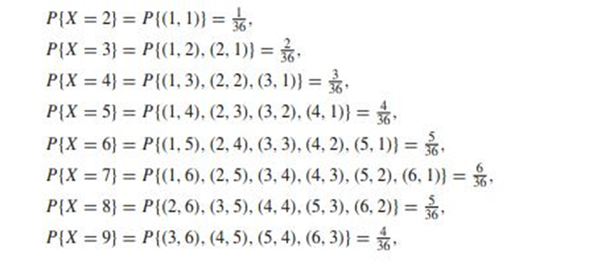
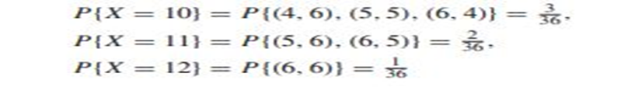
Example

Slide 5


Example Cont.
Since X must take on one of the values two through twelve, we must have
Example 2.2 For a second example, suppose that our experiment consists of tossing two fair coins. Letting Y denote the number of heads appearing, then Y is a random variable taking on one of the values 0, 1, 2 with respective probabilities

Slide 6
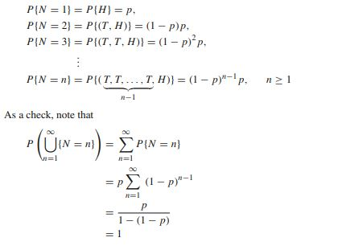
Example Cont.
Example 2.3 Suppose that we toss a coin having a probability p of coming up heads, until the first head appears. Letting N denote the number of flips required, then assuming that the outcome of successive flips are independent, N is a random variable taking on one of the values 1, 2, 3,..., with respective probabilities

Slide 7
Example Cont.
Example 2.4: Suppose that our experiment consists of seeing how long a battery can operate before wearing down. Suppose also that we are not primarily interested in the actual lifetime of the battery but are concerned only about whether or not the battery lasts at least two years. In this case, we may define the random variable I by
I = 1, if the lifetime of battery is two or more years
0, otherwise
If E denotes the event that the battery lasts two or more years, then the random variable I is known as the indicator random variable for event E. (Note that I equals 1 or 0 depending on whether or not E occurs.)

Slide 8
Example Cont.
Example 2.5: See book

Slide 9
In all of the preceding examples, the random variables of interest took on either a finite or a countable number of possible values. Such random variables are called discrete random variables.
There also exist random variables that take on a continuum of possible values. These are known as continuous random variables. One example is the random variable denoting the lifetime of a car, when the car’s lifetime is assumed to take on any value in some interval (a, b)

Slide 10
The cumulative distribution function (cdf) (or more simply the distribution function) F(·) of the random variable X is defined for any real number b,
−∞ < b < ∞, by F(b) = P{X ≤ b}
In words, F(b) denotes the probability that the random variable X takes on a value that is less than or equal to b. Some properties of the cdf F are
(i) F(b) is a no decreasing function of b
(ii) limb→∞ F(b) = F(∞) = 1
(iii) limb→−∞ F(b) = F(−∞) = 0.

Slide 11
Discrete Random Variable
A discrete random variable has a countable number of possible values.
The probability of each value of a discrete random variable is between 0 and 1, and the sum of all the probabilities is equal to 1.
It is obtained by counting values for which there are no in-between values, such as the integers 0, 1, 2, ….
Examples of discrete random variables include the values obtained from rolling a die and the grades received on a test out of 100.

Slide 12
Discrete Random Variable
For a discrete random variable X, we define the probability mass function p(a) of X by
p(a) = P{X = a}
The probability mass function p(a) is positive for at most a countable number of values of a. That is, if X must assume one of the values x1, x2,...,
then p(xi) > 0, i = 1, 2,...
p(x) = 0, all other values of x

Slide 13
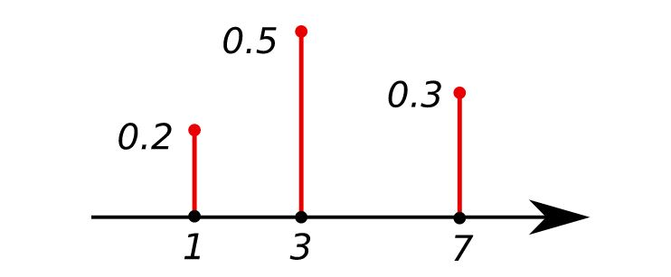
Example
Discrete Probability Distribution: This shows the probability mass function of a discrete probability distribution. The probabilities of the singletons {1}, {3}, and {7} are respectively 0.2, 0.5, 0.3. A set not containing any of these points has probability zero.

Slide 14
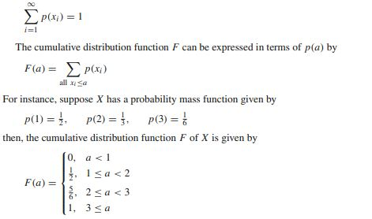
Discrete Random Variable
Since X must take on one of the values xi , we have

Slide 15
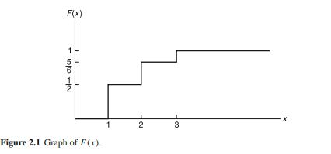
Discrete Random Variable

Slide 16

The Bernoulli Random Variable
Suppose that a trial, or an experiment, whose outcome can be classified as either a “success” or as a “failure” is performed. If we let X equal 1 if the outcome is a success and 0 if it is a failure, then the probability mass function of X is given by
where p, 0 ≤ p ≤ 1, is the probability that the trial is a “success.”

Slide 17
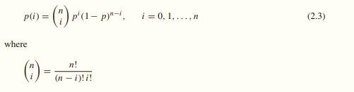
The Binomial Random Variable
Suppose that n independent trials, each of which results in a “success” with probability p and in a “failure” with probability 1 − p, are to be performed. If X represents the number of successes that occur in the n trials, then X is said to be a binomial random variable with parameters (n, p). The probability mass function of a binomial random variable having parameters (n, p) is given by

Slide 18

Binomial Random Variable Cont.

Slide 19

Example
Example 2.6 Four fair coins are flipped. If the outcomes are assumed independent, what is the probability that two heads and two tails are obtained?
Solution:

Slide 20
Example
Example 2.7 It is known that any item produced by a certain machine will be defective with probability 0.1, independently of any other item. What is the probability that in a sample of three items, at most one will be defective?

Slide 21
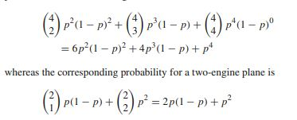
Example
Example 2.8 Suppose that an airplane engine will fail, when in flight, with probability 1 − p independently from engine to engine; suppose that the airplane will make a successful flight if at least 50 percent of its engines remain operative. For what values of p is a four-engine plane preferable to a two-engine plane?
Solution:

Slide 22
Example
Hence the four-engine plane is safer if
6p2*(1 − p) 2 + 4p3*(1 − p) + p4 ≥ 2p*(1 − p) + p2
or equivalently if
6p(1 − p) 2 + 4p2(1 − p) + p3 ≥ 2 − p
which simplifies to
3p3 − 8p2 + 7p − 2 ≥ 0 or (p − 1) 2(3p − 2) ≥ 0
which is equivalent to
3p − 2 ≥ 0 or p ≥ 2 3

Slide 23

Example
Suppose that a particular trait of a person (such as eye color or left handedness) is classified on the basis of one pair of genes and suppose that d represents a dominant gene and r a recessive gene. Thus a person with dd genes is pure dominance, one with rr is pure recessive, and one with r d is hybrid. The pure dominance and the hybrid are alike in appearance. Children receive one gene from each parent. If, with respect to a particular trait, two hybrid parents have a total of four children, what is the probability that exactly three of the four children have the outward appearance of the dominant gene?
Solution:

Slide 24


The Geometric Random Variable
Suppose that independent trials, each having probability p of being a success, are performed until a success occurs. If we let X be the number of trials required until the first success, then X is said to be a geometric random variable with parameter p. Its probability mass function is given by

Slide 25

The Poisson Random Variable
An important property of the Poisson random variable is that it may be used to approximate a binomial random variable when the binomial parameter n is large and p is small. To see this, suppose that X is a binomial random variable with parameters (n, p), and let λ = np. Then

Slide 26
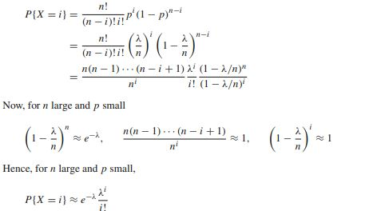
The Poisson Random Variable

Slide 27
Example
Example 2.10 Suppose that the number of typographical errors on a single page of this book has a Poisson distribution with parameter λ = 1. Calculate the probability that there is at least one error on this page.
Solution:

Slide 28
Example
Example 2.11 If the number of accidents occurring on a highway each day is a Poisson random variable with parameter λ = 3, what is the probability that no accidents occur today?
Solution:

Slide 29

Example
Example 2.12 Consider an experiment that consists of counting the number of α-particles given off in a one-second interval by one gram of radioactive material. If we know from past experience that, on the average, 3.2 such α-particles are given off, what is a good approximation to the probability that no more than two α-particles will appear?
Solution:

Slide 30
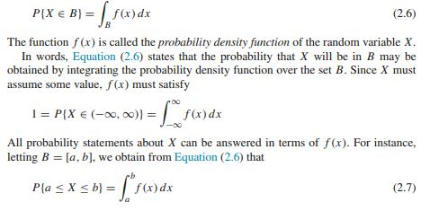
Continuous Random Variables
In this section, we shall concern ourselves with random variables whose set of possible values is uncountable. Let X be such a random variable. We say that X is a continuous random variable if there exists a nonnegative function f (x), define

Slide 31
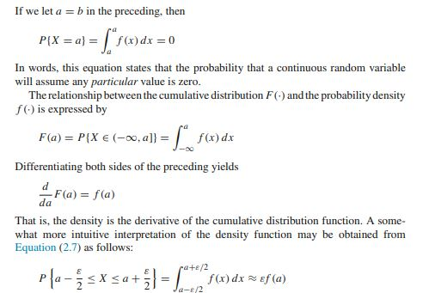
Continuous Random Variables

Slide 32
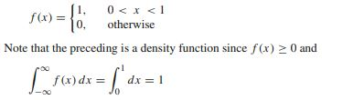
The Uniform Random Variable
A random variable is said to be uniformly distributed over the interval (0, 1) if its probability density function is given by

Slide 33


The Uniform Random Variable
To check this, note that, for any 0 < a < b < 1,
In other words, the probability that X is in any particular subinterval of (0, 1) equals the length of that subinterval.
In general, we say that X is a uniform random variable on the interval (α, β) if its
probability density function is given by

Slide 34
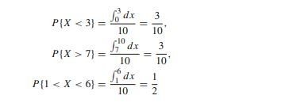
Example
Example 2.14 If X is uniformly distributed over (0, 10), calculate the probability that (a) X < 3, (b) X > 7, (c) 1 < X < 6.

